Slide 1
Reversing satellite reaction wheels
Binary and Hardware Analysis
-CPT Tyler Bertles

Slide 2
setup
Software:
WSL (vbindiff, crc32)
VS Code (or hex editor of choice)
Files (Teams->CY25->Files->Class Presentations):
Controlprog(.hex / .cs)
Bootloader(.hex / .cs)
RW_crop.png

Slide 3
Walkthrough Overview
A Reaction Wheel is a satellite component designed to store rotational energy via spinning discs. It can cause or prevent rotation of the satellite.
Our reaction wheel is designed by CubeSpace. The vendor documentation indicates that this device operates with bare-metal firmware consisting of a bootloader(R/W functionality) and control program (command and telemetry).
We will look at these files along with the hardware and some chipset documentation.

Slide 4
Who cares?
Space is no longer the domain of nation-states. The private sector is launching more devices at a faster rate than ever before.
Speed = $ = security not worth delayed Time to Market.
Many components, including our reaction wheel, are now Commercial Off-the-Shelf (COTS) devices, increasing the attack surface for new satellites.
These devices are not designed with security in mind -> I aim to demonstrate that these security gaps can lead to the loss of satellite control.
Research end-goal: Rootkit deployment via vendor software update functionality.

Slide 5
File manipulation
Vendor claims bare-metal programming -> Need a binary file. Gave us a .hex and a .cs (proprietary)
Hex to Binary:
Open WSL
objcopy --input-target=ihex --output-target=binary controlprog.hex cpfromhex.bin
Size check: 193KB

Slide 6
Control Program
We have a .bin, what now?
Strings
What is a .cs? -> Hex Editor comparison

Slide 7
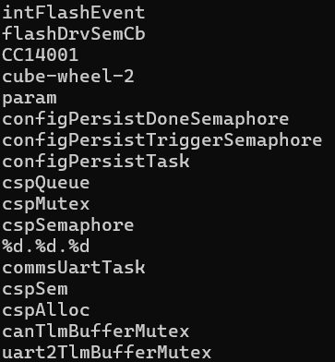

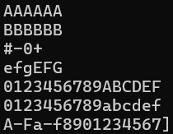
Control Program
Strings
At top: Device info and possible compiler info
Near bottom: command names, hex chars?

Slide 8
Control Program
Hex Comparison: .bin and .cs
Look at file data for both files -> Anything interesting?
Open both files in VS Code (or hex editor of choice)
What do we see?
What is a .cs?
Notes:
.bin and .cs are same size? -> same thing?
Files appear to be the same except for a header on the .cs
.cs is just a binary with a header -> we should analyze the header

Slide 9
.cs Analysis
Theory: .cs is a binary with a header -> split header and compare files
Delete the header from ‘cpfromhex.bin’ -> save as cptrim.bin
Re-open ‘cpfromhex.bin’ -> delete everything except header -> save as cphead.bin
NOTE: If using VSCode, double check file after trimming. Sometimes corrupts new file when creating it.
Size check: cphead=1KB, cptrim=193KB

Slide 10
.cs Analysis
Compare cptrim.bin and cpfromhex.bin
WSL
vbindiff cptrim.bin cpfromhex.bin
Results?
Notes:
Both files are identical

Slide 11
.cs header
What can we learn from the header?
Open cphead.bin and cptrim.bin in VS Code
Bytes 00-01
72 and 00’s -> Where else do we see 0x72?
If we assume even byte-length fields -> Can we make an assumption about endianness?
Notes:
Length of header
Most likely little endian

Slide 12
.cs header
What can we learn from the header?
Assuming little endian
Bytes 06-09
70 03 03 00 -> 00030370 -> Do we see this somewhere?
We’ve seen one length field already, what else has a length?
Notes:
Length of data

Slide 13
.cs header
What can we learn from the header?
Assuming little endian
Bytes 0A-0D
06 71 AD 71 -> 71AD7106 -> Do we see this somewhere?
Not in file, but presumably header only contains info about the file.
How could a bare-metal system confirm data?
WSL
crc32 cptrim.bin
Notes:
CRC

Slide 14
.cs header
What can we learn from the header?
Bytes 0E-11
00 40 01 08 -> 08014000 -> Do we see this somewhere?
Not a CRC, not in the file -> let’s take a field trip

Slide 15
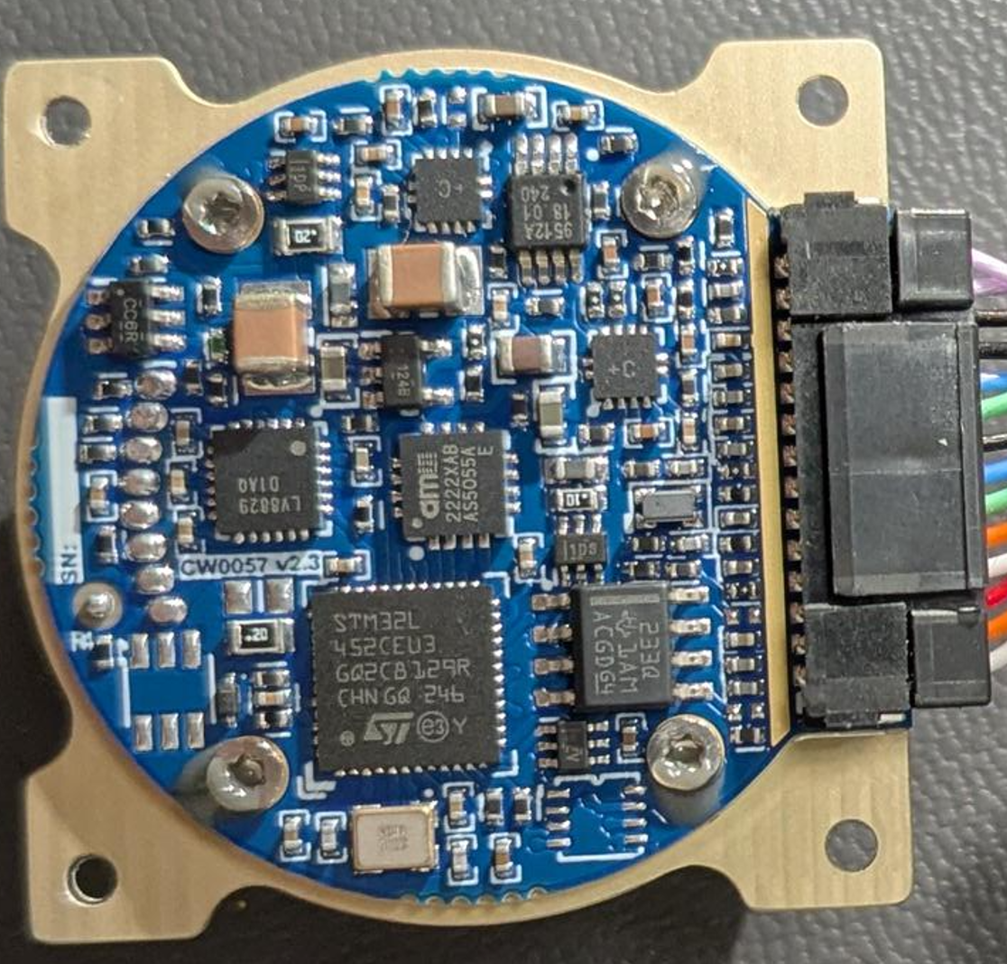
Hardware analysis
Open RW_crop.png
This is a close-up of the internal board of the Reaction Wheel.
What is our processor?
How could I get more info about this processor?
Notes:
STM32L ……
Google the item -> data sheets

Slide 16
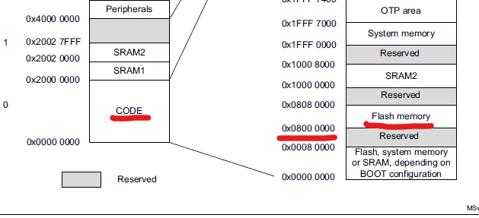
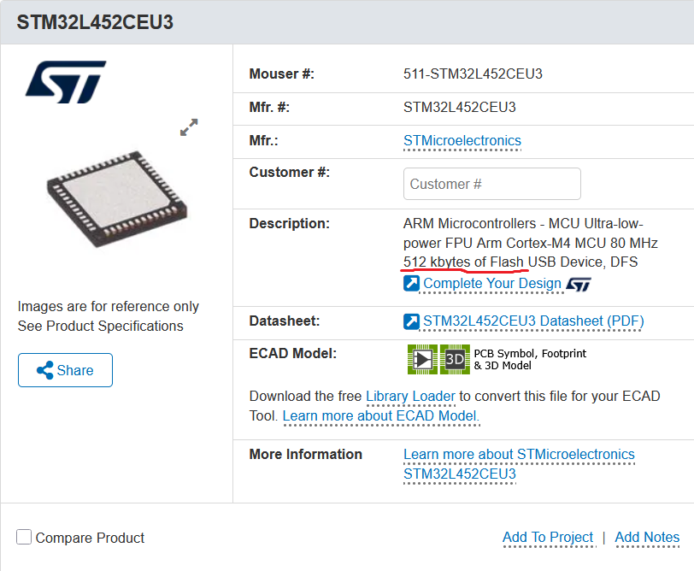
datasheet analysis
Check the data sheet for this processor
STM32L452CEU3
Memory map snippet -> Flash memory starts 0x08000000
Notes:
STM32L ……
Google the item -> data sheets

Slide 17
.cs header
What can we learn from the header?
08014000 -> Very likely a write address in flash memory.

Slide 18
.cs header
What can we learn from the header?
Bytes 12-15, 16-19, 1A-1D
Hold values 0x03, 0x01, 0x30
What are these?
Notes:
I don’t know yet -> possibly configuration parameters.

Slide 19
.cs header
What can we learn from the header?
Bytes 26-45, 46-65
Hold string values -> Either 16 byte field and padding, or 32 byte field
Strings contain device name and software name

Slide 20
.cs header
What can we learn from the header?
Bytes 66-6D
03 04 02 00, 04 05 00 00 -> 00020403, 00000504
Do we see these anywhere?
If possible, cheat with vendor aids
These numbers appear within the “build number, version number” fields on vendor loading software

Slide 21
.cs header
What can we learn from the header?
Bytes 6E-71
D2 84 C8 66 -> 66C884D2
Do we see this anywhere?
Not definitive, but if I have a build and version number, what other build data might be included?
Convert to decimal = 1724417234
Equates to Unix timestamp of 23AUG2024
Notes:
Timestamp

Slide 22
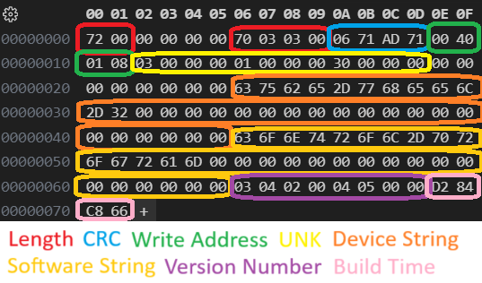
.cs header
Header info compilation:

Slide 23
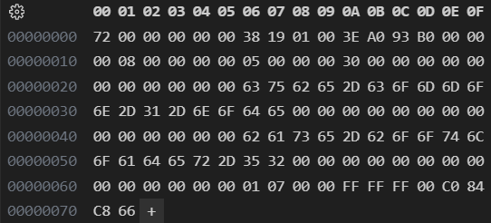
.BL header
Bootloader header:
Fields lineup -> crc matches bltrim.bin, writes to base flash address (0x08000000), timestamp same day
Notes:
Magic number?

Slide 24
Options for Binary modification
What next?
Can I fit a rootkit on this device?
Memory on chip (512KB)
Bootloader fills 0x08000000 to 0x08011938
Control Program fills 0x08014000 to 0x08044370
Flash available until 0x0807FFFF
I’ve got ~240KB of empty space on the processor flash memory

Slide 25
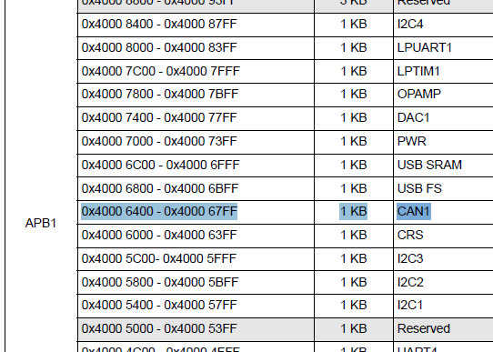
Binary disassembly
Analysis in Ghidra -> Let’s look for communication protocols
How do I find supported protocols? Back to the documentation.
Address space for CAN?
0x40006400 base addr

Slide 26
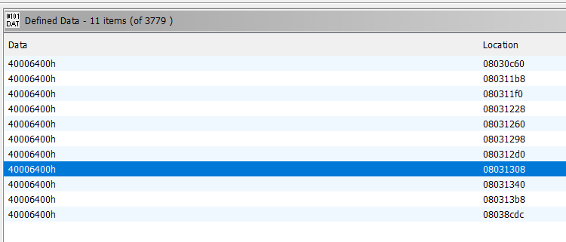
Binary disassembly
Let’s look for 40006400 in our binary.
Ghidra found that data in several places.

Slide 27
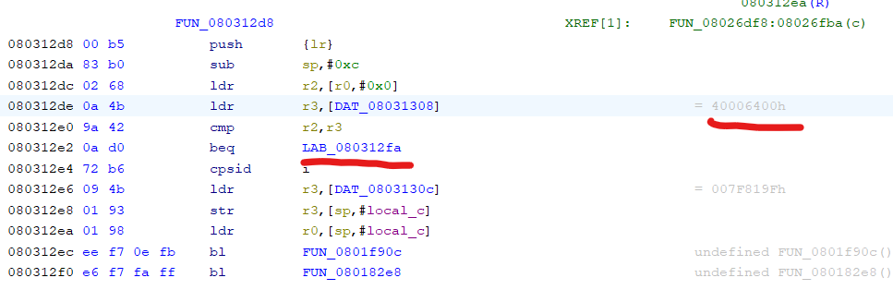
Binary disassembly
This function is likely associated with facilitating CAN comms.

Slide 28
Questions?

